Slide 1

The following are some
Amazing Holes
(click to advance through the screens)

Slide 2
Kimberley Big Hole – South Africa
Apparently the largest ever hand-dug excavation in the world, this 1097 meter deep mine yielded over 3 tons of diamonds before being closed in 1914.
The amount of earth removed by workers is estimated to total 22.5 million tons.

Slide 3
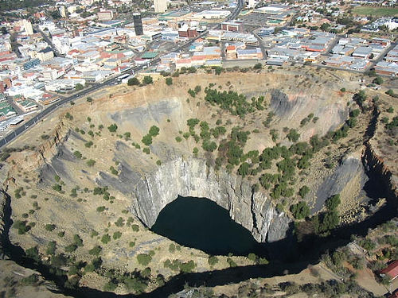

Slide 4
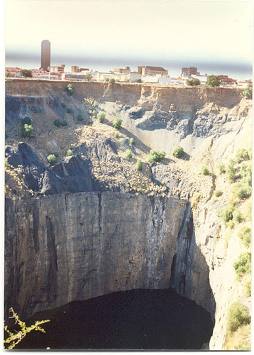

Slide 5
Glory Hole - Monticello Dam
A glory hole is used when a dam is at full capacity and water needs to be drained from the reservoir.

Slide 6
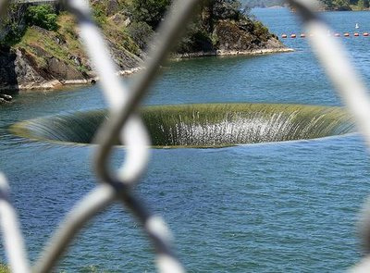

Slide 7
This is the glory hole belonging to Monticello Dam in California and it's the largest in the world, its size enabling it to consume 14,400 cubic feet of water every second.

Slide 8
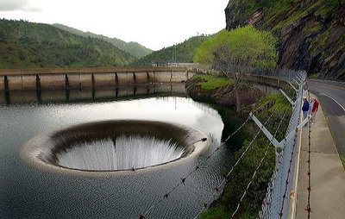

Slide 9
If you were to jump in for some reason, your slightly damp body would shoot out near the bottom of the dam

Slide 10
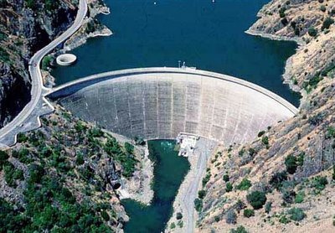

Slide 11
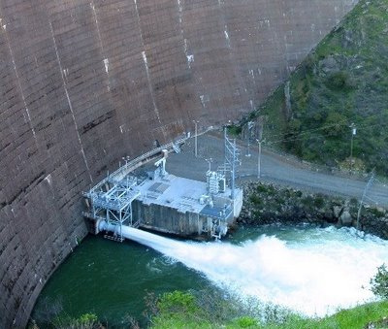

Slide 12
Bingham Canyon Mine, Utah
This is supposedly the largest man-made excavation on earth. Extraction began in 1863 and still continues today, the pit increasing in size constantly... in its current state the hole is 3/4 mile deep and 2.5 miles wide.

Slide 13
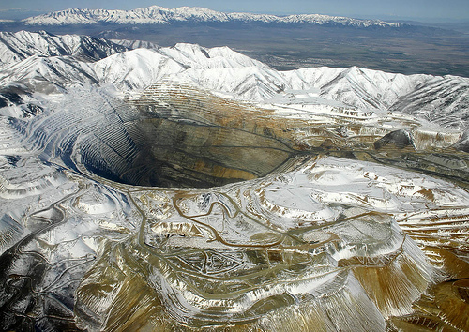

Slide 14
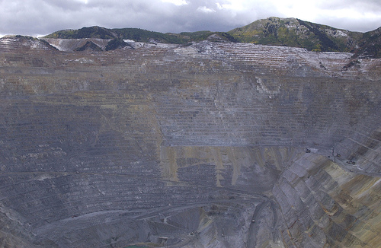

Slide 15
Great Blue Hole , Belize
Situated 60 miles off the mainland of Belize is this incredible, geographical phenomenon known as a blue hole. There are numerous blue holes around the world but none as stunning as this one.
At surface level the near perfectly circular hole is 1/4 mile wide, the depth in the middle reaching 145 meters. Obviously the hole is a huge hit with divers.

Slide 16
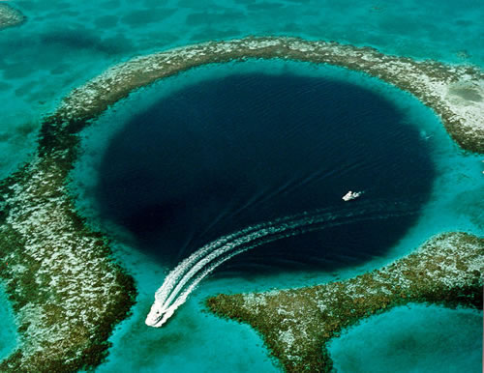

Slide 17
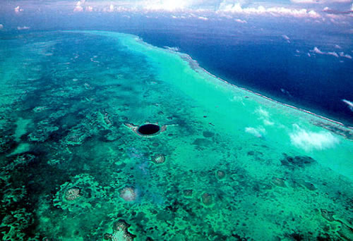

Slide 18
Mirny Diamond Mine , Serbia
Most people have seen this one. It's an absolute beast and holds the title of largest open diamond mine in the world at 525 meters deep with a top diameter of 1200 meters. There's even a no-fly zone above the hole due to a few helicopters being sucked in.
The red arrow in the second photo
is pointing to a huge truck.

Slide 19
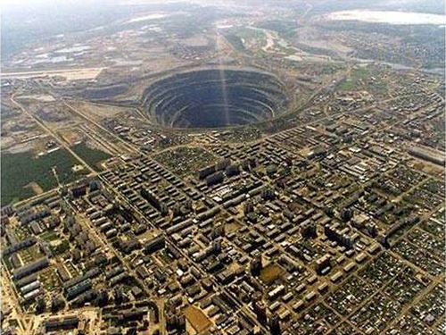

Slide 20
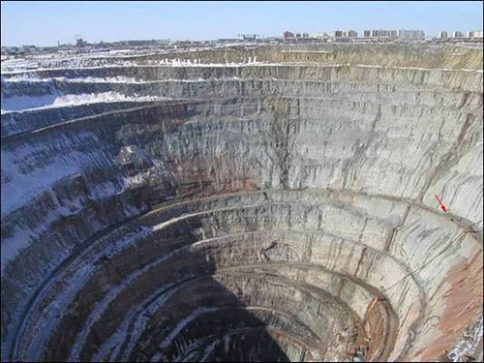

Slide 21
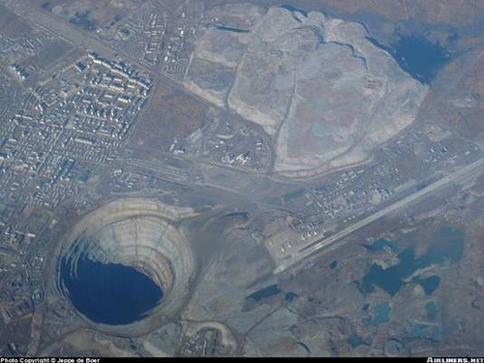

Slide 22
Diavik Mine, Canada
This incredible mine can be found 300km northeast of Yellowknife in Canada...
The mine is so huge and the area so remote that it even has its own airport with a runway large enough to accommodate a Boeing 737.

Slide 23
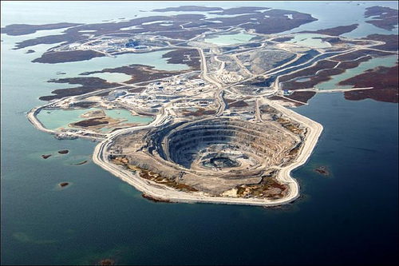

Slide 24
It looks equally as cool
when the surrounding water is frozen.
This is when the ice-road truckers bring supplies.

Slide 25
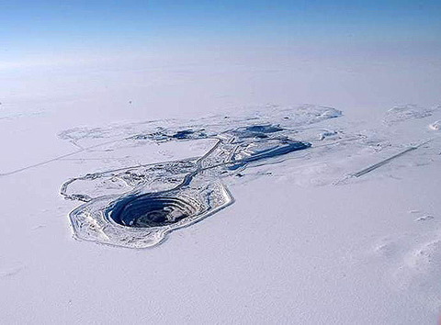

Slide 26
Sinkhole , Guatemala
A sinkhole is caused when water (usually rainwater or sewage) is soaked up by the earth on a large scale, resulting in the ground collapsing.
These photos are of a sinkhole which occurred early this year in Guatemala. The hole swallowed a dozen homes and killing at least 3 people.
Officials blamed the monster of a hole on a ruptured sewage pipe.

Slide 27
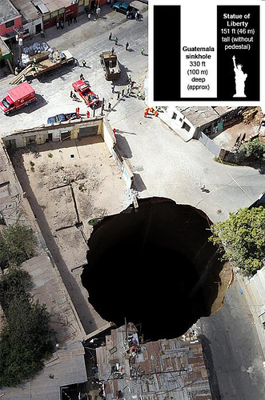

Slide 28
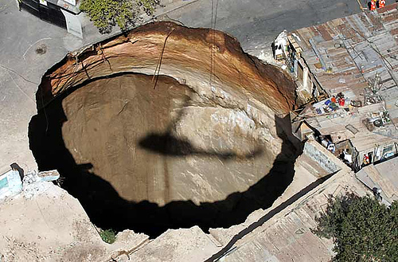

Slide 29
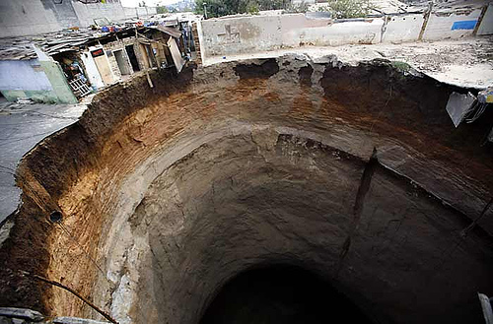

Slide 30
Now, two of the biggest holes...

Slide 31



Slide 32
THESE ARE CALLED ASS-HOLES.
They are both capable of soaking up more of your tax dollars than any of the previous holes.

Slide 33


